Slide 1
Introducing NEST
Using an Ecological Perspective to Screen Young Children for Developmental Risk and Resilience
Carmela J. DeCandia, Psy.D. • Katie Volk, Ph.D.
Notes:
kv
NBCDI – testing across diversity. Why it matters? Look at proposals. CDC – look at class slides.
ACE data
Environmental risks crosswalked to race
Cronholm

Slide 2
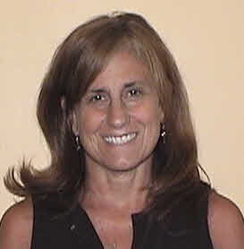



Creators of NEST
Carmela J. DeCandia, Psy.D., Principal Investigator
Owner & President, Artemis Associates
  Katie Volk, MA, Principal Investigator
  Formerly of the Center for Social Innovation; Artemis Senior Associate
  Jay Unick, Ph.D., Research Statistician, Associate Professor,
  University of Maryland Baltimore School of Social Work
  Rosie Donegan, MA, Research Associate,
  Center for Social Innovation
* Originally developed in partnership with the Center for Social Innovation.
Notes:
kv
WHAT WE PROPOSED:
Traditional developmental screening tools can be difficult to implement and are often normed on middle class white children. By contrast, NEST is an easy-to-use, psychometrically- validated online screening tool normed on a nationwide sample of homeless children (ages 3- 5) who are racially and culturally diverse. Bulit for paraprofessionals working in low-resource settings, NEST encourages dialogue between providers and caregivers, identifies a child’s potential for developmental risk, and provides actionable recommendations to build resilience. Join us to learn how we created NEST, what our data have told us so far, and how you can use NEST to work with families and children.

Slide 3
NEST Advisory Committee
Ellen Bassuk, M.D. Owner, Center for Social Innovation
Susan Douglas, Ph.D., Assistant Professor of the Practice of Human Development, Department of Leadership, Policy, and Organizations
Mary Haskett, Ph.D., Professor of Psychology at North Carolina State University
Janette Herbers, Ph.D., Assistant Professor of Psychology, Villanova University’s College of Liberal Arts and Sciences,
Lenore Rubin, Ph.D., Child Psychologist, King County Public Health Childcare Health Team
Notes:
kv
WHAT WE PROPOSED:
Traditional developmental screening tools can be difficult to implement and are often normed on middle class white children. By contrast, NEST is an easy-to-use, psychometrically- validated online screening tool normed on a nationwide sample of homeless children (ages 3- 5) who are racially and culturally diverse. Bulit for paraprofessionals working in low-resource settings, NEST encourages dialogue between providers and caregivers, identifies a child’s potential for developmental risk, and provides actionable recommendations to build resilience. Join us to learn how we created NEST, what our data have told us so far, and how you can use NEST to work with families and children.

Slide 4
NEST Funding
  NEST was originally developed in partnership with the Center for Social Innovation and funded by the Eunice Kennedy Shriver National Institute of Child Health and Human Development (NICHD (Grant #1 R44 HD088291-01). The NICHD approved the study design during the grant review process but was not involved decisions about data analyses and platform development.
Notes:
kv
WHAT WE PROPOSED:
Traditional developmental screening tools can be difficult to implement and are often normed on middle class white children. By contrast, NEST is an easy-to-use, psychometrically- validated online screening tool normed on a nationwide sample of homeless children (ages 3- 5) who are racially and culturally diverse. Bulit for paraprofessionals working in low-resource settings, NEST encourages dialogue between providers and caregivers, identifies a child’s potential for developmental risk, and provides actionable recommendations to build resilience. Join us to learn how we created NEST, what our data have told us so far, and how you can use NEST to work with families and children.

Slide 5

Neurodevelopmental
Ecological
Screening
Tool
An instrument to screen children’s development that can be administered by nonclinical staff in low-resourced settings
Notes:
REFORMAT

Slide 6
Features
Developed with a diverse sample
Ecological framework
Assesses risk/protective factors
Online and user friendly
Designed for non-clinical professionals
Actionable recommendations in real-time
Notes:
REFORMAT

Slide 7
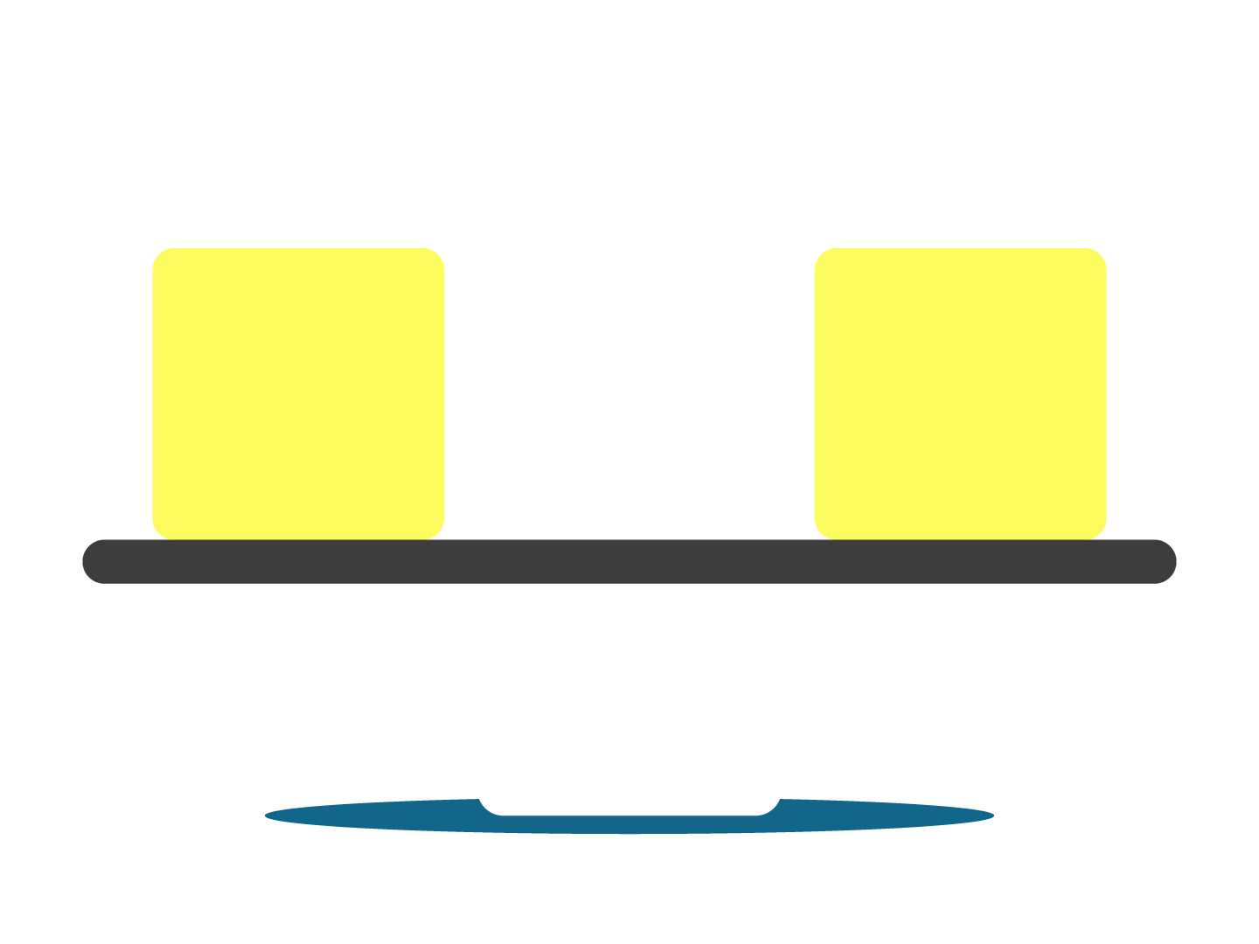
The Science of Risk & Resilience
Protective
Risk
Individual
Family
Environment

Slide 8
Assessment vs. Screening
Assessment
Screening
Scope: Broad/Deep.
Time: Lengthy.
Purpose: Diagnostic.
Scope: Narrow/Snapshot.
Time: Brief.
Purpose: Determine Risk.
Notes:
REFORMAT

Slide 9
Why Screen for Developmental Risk:
4 Critical Needs

Slide 10

Addressing a Critical Need:
1: Prevalence of Risks—Child
Developmental Delay
6-7% US children (age 3-17) diagnosed
2x Children living in poverty
2x Hispanic and Black children
25% Young children who are homeless
Sources: National Child Health Survey, 2017; Child Trends, 2013; Haskett et al, 2015, RWJF, 2017
Notes:
https://www.childtrends.org/wp-content/uploads/2015/10/111_Developmental-Risk-and-Screening.pdf
https://www.cdc.gov/nchs/products/databriefs/db291.htm;
https://www.childtrends.org/indicators/screening-and-risk-for-developmental-delay
From Child Trends: Regardless of family income, children are equally likely to be screened for developmental delays. (Appendix 1) However, children living at or below the poverty line are more than twice as likely to be at high risk for developmental delays as their peers living at more than twice the poverty line (19 and seven percent, respectively). Those living in families with incomes above but less than twice the poverty line fall in between, with 10 percent having a high risk for delays. Poor children are also more likely than children living at more than twice the poverty line to have a moderate risk for delays. However, this difference is smaller (17 and 14 percent, respectively). (Figure 3) The proportion of poor children who are at high risk has increased since 2003 (from 14 to 19 percent), but the proportion of children living at more than twice the poverty line who were at high risk has remained the same. (Appendix 2)

Slide 11
Addressing a Critical Need:
1: Prevalence of Risks—Child
Adverse Childhood Experiences (ACE) One or more
40% White children
51% Hispanic children
64% Black children
62% children with family incomes under 200 percent of the federal poverty level
Sources: National Child Health Survey, 2017; Child Trends, 2013; Haskett et al, 2015, RWJF, 2017
Notes:
https://www.childtrends.org/wp-content/uploads/2015/10/111_Developmental-Risk-and-Screening.pdf
https://www.cdc.gov/nchs/products/databriefs/db291.htm;
https://www.childtrends.org/indicators/screening-and-risk-for-developmental-delay
From Child Trends: Regardless of family income, children are equally likely to be screened for developmental delays. (Appendix 1) However, children living at or below the poverty line are more than twice as likely to be at high risk for developmental delays as their peers living at more than twice the poverty line (19 and seven percent, respectively). Those living in families with incomes above but less than twice the poverty line fall in between, with 10 percent having a high risk for delays. Poor children are also more likely than children living at more than twice the poverty line to have a moderate risk for delays. However, this difference is smaller (17 and 14 percent, respectively). (Figure 3) The proportion of poor children who are at high risk has increased since 2003 (from 14 to 19 percent), but the proportion of children living at more than twice the poverty line who were at high risk has remained the same. (Appendix 2)

Slide 12
Addressing a Critical Need:
1: Prevalence of Risks—Child
Adverse Childhood Experiences (ACE) children ages 3 – 5
Impacts a child’s social emotional development and chances of school success.
2+ ACEs 4x more likely to have trouble calming themselves down, be easily distracted, and have a hard time making and keeping friends.
75% children ages 3 to 5 who have been expelled from preschool also had ACEs.
Source: RWJF (2017) https://www.rwjf.org/en/library/articles-and-news/2017/10/traumatic-experiences-widespread-among-u-s--youth--new-data-show.html
Notes:
https://www.childtrends.org/wp-content/uploads/2015/10/111_Developmental-Risk-and-Screening.pdf
https://www.cdc.gov/nchs/products/databriefs/db291.htm;
https://www.childtrends.org/indicators/screening-and-risk-for-developmental-delay
From Child Trends: Regardless of family income, children are equally likely to be screened for developmental delays. (Appendix 1) However, children living at or below the poverty line are more than twice as likely to be at high risk for developmental delays as their peers living at more than twice the poverty line (19 and seven percent, respectively). Those living in families with incomes above but less than twice the poverty line fall in between, with 10 percent having a high risk for delays. Poor children are also more likely than children living at more than twice the poverty line to have a moderate risk for delays. However, this difference is smaller (17 and 14 percent, respectively). (Figure 3) The proportion of poor children who are at high risk has increased since 2003 (from 14 to 19 percent), but the proportion of children living at more than twice the poverty line who were at high risk has remained the same. (Appendix 2)

Slide 13

Addressing a Critical Need:
2: Prevalence—Parents
“Extremely poor and homeless women have disproportionately high rates of depression that are compounded by their circumstances.”
—Bassuk & Beardslee, 2016
25% mothers living in poverty; ethnic/racial minorities
40% to 60% low-income mothers with young children
45% to 85% mothers experiencing homelessness
Sources: Hayes et al., 2013, Weinreb et al., 2006 Bassuk et al, 1998; Grote, Zukoff, Swartz, Bledsoe, & Geibel, 2007; Kessler et al., 2003; Knitzer, Theberge, & Johnson, 2008.)
Notes:
https://www.childtrends.org/wp-content/uploads/2015/10/111_Developmental-Risk-and-Screening.pdf
https://www.cdc.gov/nchs/products/databriefs/db291.htm;
https://www.childtrends.org/indicators/screening-and-risk-for-developmental-delay
From Child Trends: Regardless of family income, children are equally likely to be screened for developmental delays. (Appendix 1) However, children living at or below the poverty line are more than twice as likely to be at high risk for developmental delays as their peers living at more than twice the poverty line (19 and seven percent, respectively). Those living in families with incomes above but less than twice the poverty line fall in between, with 10 percent having a high risk for delays. Poor children are also more likely than children living at more than twice the poverty line to have a moderate risk for delays. However, this difference is smaller (17 and 14 percent, respectively). (Figure 3) The proportion of poor children who are at high risk has increased since 2003 (from 14 to 19 percent), but the proportion of children living at more than twice the poverty line who were at high risk has remained the same. (Appendix 2)

Slide 14
Addressing a Critical Need:
2: Prevalence—Parents
“Exposure to trauma is directly related to socioeconomic status (SES) in a dose response manner such that lower income is associated with increased traumatic exposure.”
“Children who grow up in economically disadvantaged families and communities are at increased risk for what is referred to as a “toxic stress response.”
—American Psychological Association
90%+ homeless mothers exposed to child/adult trauma
30%+ homeless mothers meet criteria for PTSD
Sources: Hayes et al., 2013, Weinreb et al., 2006 Bassuk et al, 1998; Grote, Zukoff, Swartz, Bledsoe, & Geibel, 2007; Santiago, Kaltman, & Miranda, 2013; Sedlak et al., 2010;
Kessler et al., 2003; Knitzer, Theberge, & Johnson, 2008, file:///C:/Users/Carmela%20DeCandia/Downloads/economically-disadvantaged.pdf )
Notes:
https://www.childtrends.org/wp-content/uploads/2015/10/111_Developmental-Risk-and-Screening.pdf
https://www.cdc.gov/nchs/products/databriefs/db291.htm;
https://www.childtrends.org/indicators/screening-and-risk-for-developmental-delay
From Child Trends: Regardless of family income, children are equally likely to be screened for developmental delays. (Appendix 1) However, children living at or below the poverty line are more than twice as likely to be at high risk for developmental delays as their peers living at more than twice the poverty line (19 and seven percent, respectively). Those living in families with incomes above but less than twice the poverty line fall in between, with 10 percent having a high risk for delays. Poor children are also more likely than children living at more than twice the poverty line to have a moderate risk for delays. However, this difference is smaller (17 and 14 percent, respectively). (Figure 3) The proportion of poor children who are at high risk has increased since 2003 (from 14 to 19 percent), but the proportion of children living at more than twice the poverty line who were at high risk has remained the same. (Appendix 2)

Slide 15
Addressing a Critical Need:
3: Ecological Context
Child:
Genetics & Temperament
Living Environment
Zip Code
SES
Nutrition
Food Security
Health Care Access
Homelessness
Residential Instability
Lead
Notes:
ASK: What factors support/inhibit development?

Slide 16
Addressing a Critical Need:
4: Support Providers/Teachers
?
Time
Money
Expertise
Training

Slide 17
Addressing a Critical Need:
4: Support Providers/Teachers
Child
Norms
Caregiver
Environment
Ages & Stages (gross, fine, problem-solving, personal-social, general parental concerns)
Brigance (communication, academic, motor)
Denver (personal/social, gross/fine motor, language)
PEDS (cognitive, language, gross/fine, behavior, social-emotional, self-help, school)
66% white, 54% 4+ years college,
65% white, 54% completed college
54-60% white, Colorado
65% white, 25% low-income, represents US @ 1996 Census
PHQ-9 (depression)
PCL (PTSD symptoms)
ACE (trauma exposure)
Parenting Assessment of Protective Factors
PSI-V (parenting stress)
Arnold (parenting behaviors)
AAPI (parenting competence/quality of relationship to child)
DAST-10
GAD-7 (anxiety)
VI-SPDAT (housing)
USDA/state-based lead screener
Child ACE
Social Support Screener
USDA Food Security
Combine into recommendations.
Notes:
Numerous tools and instruments are currently available to assess children’s neurodevelopmental status.
The Ohio Department of Education152 catalogued 80 tools for use with children aged 0 to 5, and 93 tools specifically for children 0–3, making the selection of instruments challenging for direct service providers. Many commonly recommended instruments,153 such as Ages & Stages, were derived from normative samples of primarily white, middle-class children. They tend to be lengthy and require administrators to reference a manual to interpret results.154 Research indicates that clinical judgment is often faulty and that use of standardized instruments that provide immediate feedback can improve treatment outcomes.155,156 The American Academy of Pediatrics created a developmental screening and surveillance algorithm157,158,159 to assist primary care providers in early detection and service coordination, but it only makes recommendations appropriate for pediatricians and notes that significant gaps in research and practice persist.160 Recommendations to enhance developmental screenings for children include 1) identifying biological and environmental risk and protective factors that improve service referral thresholds; and 2) ensuring wider use of parent-completed questionnaires about their children. To date, these are only completed in pediatric settings 28% of the time.16

Slide 18
“For developmental screening to be effective it should begin early in a child’s life;
be repeated throughout early childhood;
and use reliable, valid screening tools appropriate to the age, culture, and language of the child.”
Moodie et al (2014) Early childhood developmental screening: A compendium of measures for children ages birth to five. Administration for Children and Families.
Notes:
Moodie, S., Daneri, P., Goldhagen, S., Halle, T., Green, K., & LaMonte, L. (2014). Early childhood developmental screening: A
compendium of measures for children ages birth to five (OPRE Report 201411). Washington, DC: Office of Planning,
Research and Evaluation, Administration for Children and Families, U.S. Department of Health and Human Services.

Slide 19
“This can be a challenge, since very few developmental screening tools are developed or tested with linguistically or culturally diverse samples of children.”
Moodie et al (2014) Early childhood developmental screening: A compendium of measures for children ages birth to five. Administration for Children and Families.
Notes:
Moodie, S., Daneri, P., Goldhagen, S., Halle, T., Green, K., & LaMonte, L. (2014). Early childhood developmental screening: A
compendium of measures for children ages birth to five (OPRE Report 201411). Washington, DC: Office of Planning,
Research and Evaluation, Administration for Children and Families, U.S. Department of Health and Human Services.

Slide 20
How was NEST Developed

Slide 21
Research Process
Create item pool.
Refine the items.
Test the language.
Conduct a study.
Refine the items.
Conduct small pilot.
Refine the items.
Vet with experts.

Slide 22

Creating the Item Pool
Literature Review:
  Child development, caregiver influence, environment
Input
  Experts in the field
  Family & Provider-Cognitive testing
Notes:
NEST – should be brief
QUESTIONS – multiple choice (online format)

Slide 23

Pilot Study
Sample
  5 Massachusetts programs
  n = parents of 60 children
Inclusion criteria:
  Children aged 3 – 5 experiencing homelessness
  English (5th grade)
Results:
  20 – 30 minutes
  47 worked well (no changes)
  A few need slight re-wording
  A few need to be re-thought

Slide 24
Adjustments & Final Item Pool
Play scale
  Refocus on Imaginative & Social
Parenting Scale
  Refocus on Overreactive Parenting Behaviors
Environment Scale
  Add Health Care Access, Lead, Nutrition

Slide 25
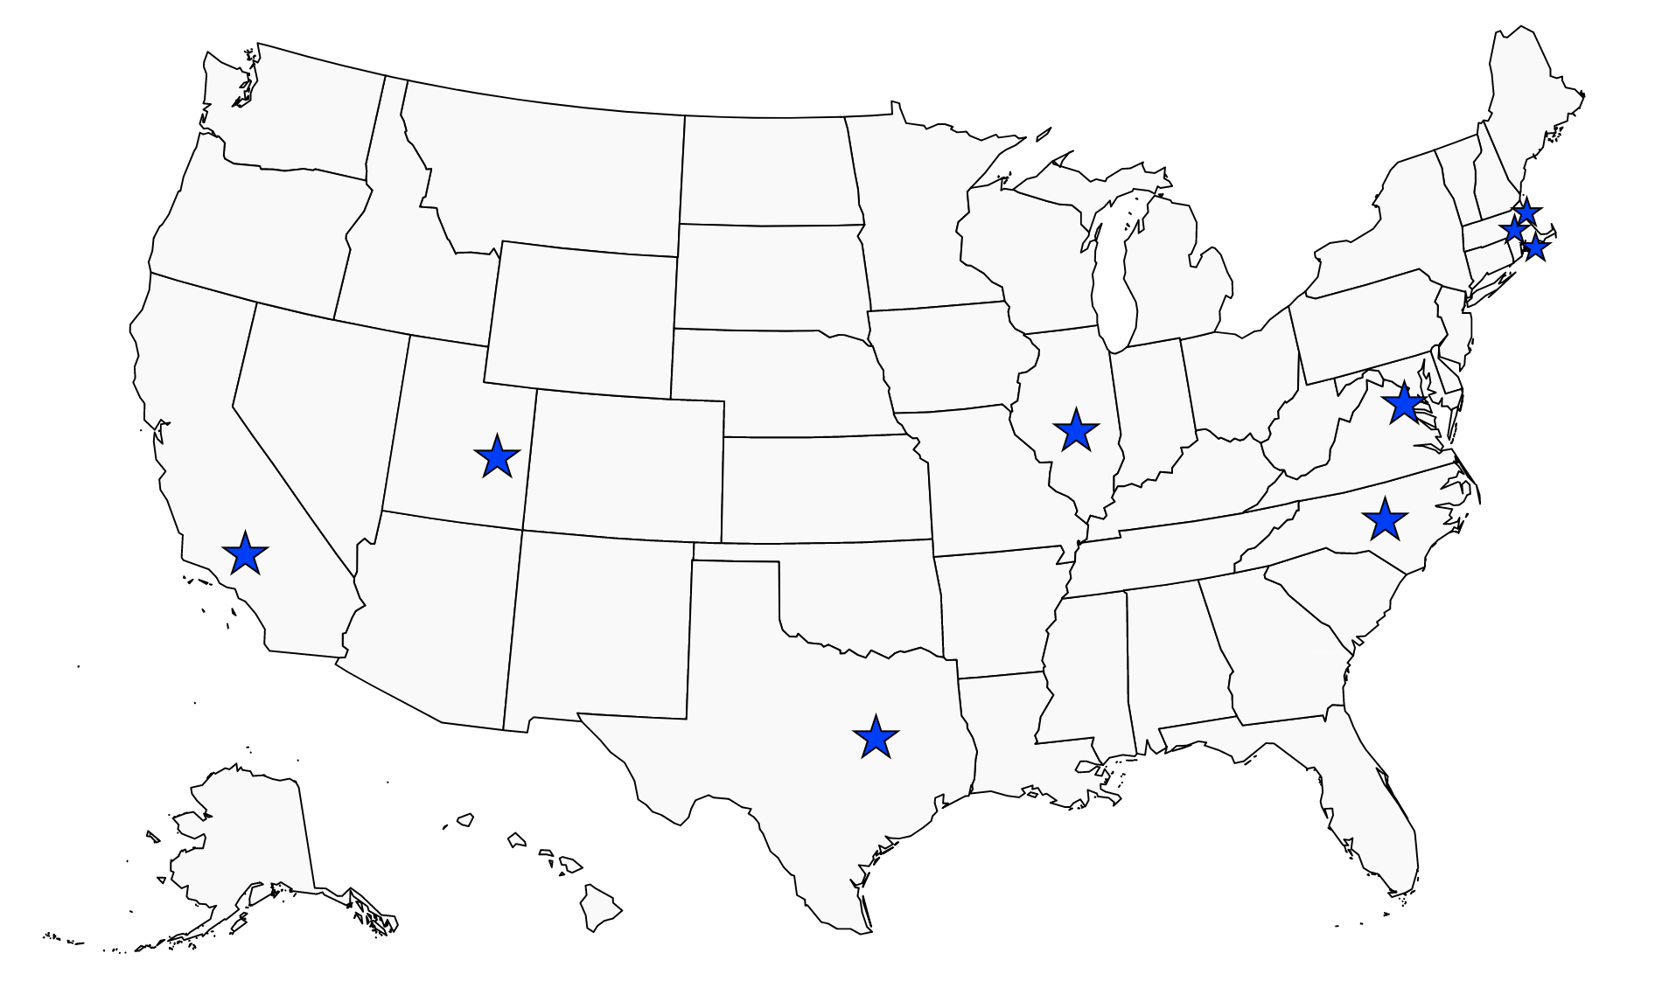
NEST SITES (PHASE II Field Testing)
9 sites nationwide Fall 2017-Spring 2018
Trained case managers to use NEST
Sample size n=230
Gold standards n=48

Slide 26
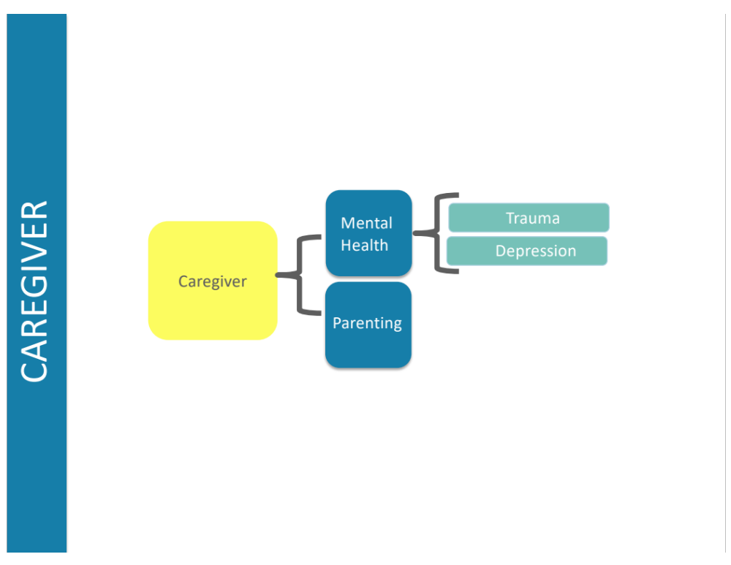
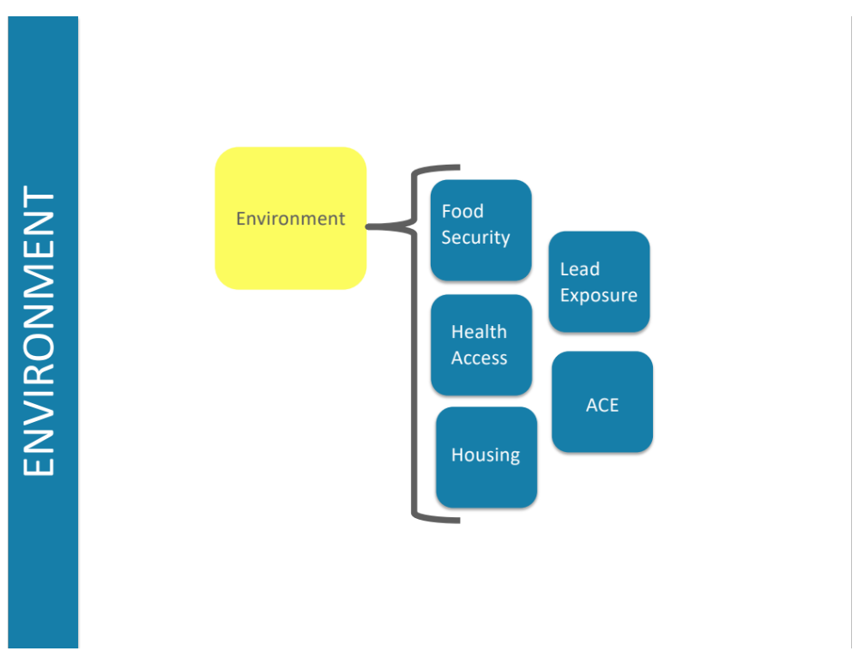
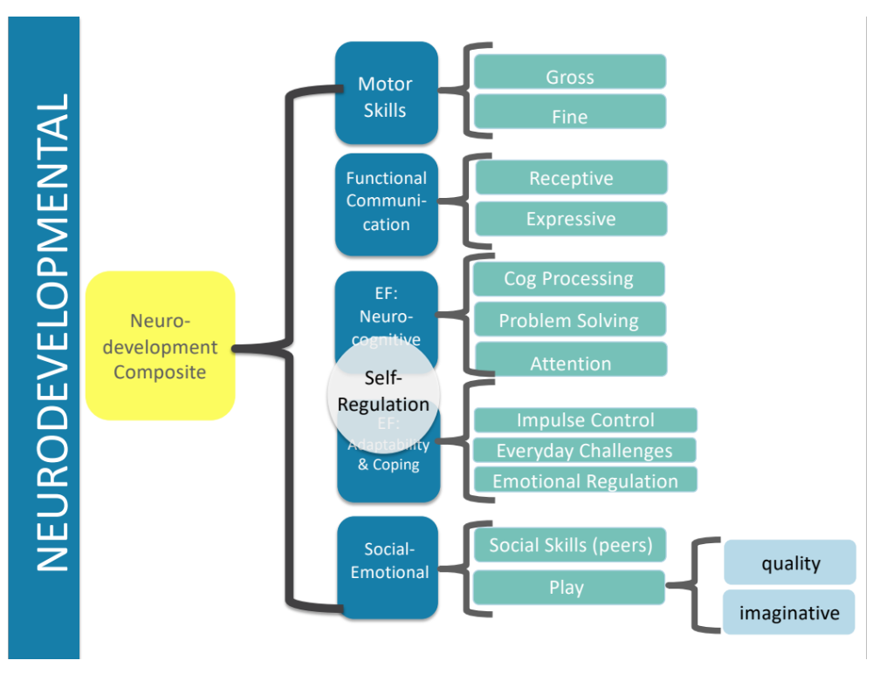
Overall
Child Score
Logic Model

Slide 27
Scoring * Recommendations
High
Immediate
intervention
Moderate
Targeted support
Low
Support strengths, monitor
Notes:
Support strengths, monitor
Increase support; make referrals
Immediate intervention

Slide 28

Why NEST?
When children are exposed to six or more risk factors, their chance that they will have a developmental delay is 90 percent.
Shonkoff (2008) Center for the Developing Child

Slide 29

Use of standardized screening reduces bias, improves accuracy, and helps us to make better informed decisions. Providers serving children need the right tools to best support children.
Notes:
Once step 1, collecting the forms, was completed, we were ready to analyze the assessments. We developed a measure by paying careful attention to the research literature on families experiencing homelessness AND a targeted review of the research on the process of assessment.
In order to analyze how well the assessments address our 4 central umbrella questions, we created a form that looked at 8 key domains. Again, these domains were not chosen randomly or based on our gut feelings, but based on the evidence.
LIST DOMAINS
-When you think about how this breaks down, we are really looking at a comprehensive framework for what families need and what families are dealing with.
Which are the most asked about/why? Least asked about?

Slide 30
Providers serving children need the right tools to best support children.
Notes:
Once step 1, collecting the forms, was completed, we were ready to analyze the assessments. We developed a measure by paying careful attention to the research literature on families experiencing homelessness AND a targeted review of the research on the process of assessment.
In order to analyze how well the assessments address our 4 central umbrella questions, we created a form that looked at 8 key domains. Again, these domains were not chosen randomly or based on our gut feelings, but based on the evidence.
LIST DOMAINS
-When you think about how this breaks down, we are really looking at a comprehensive framework for what families need and what families are dealing with.
Which are the most asked about/why? Least asked about?

Slide 31

Final Thoughts
The most potent solutions to pressing social issues often come from a combination of on-the-ground clinical experience and a robust literature base.
NEST was designed to put the right tools in the hands of the people working with low-income children and families.
(DeCandia et al., 2020

