Slide 1
Main Features
Using an Ecological Perspective to Screen Young Children for Developmental Risk and Resilience
Presenter
| Date
Carmela J. DeCandia, Psy.D.∙ Katie Volk, Ph.D.
Notes:
kv
NBCDI – testing across diversity. Why it matters? Look at proposals. CDC – look at class slides.
ACE data
Environmental risks crosswalked to race
Cronholm

Slide 2
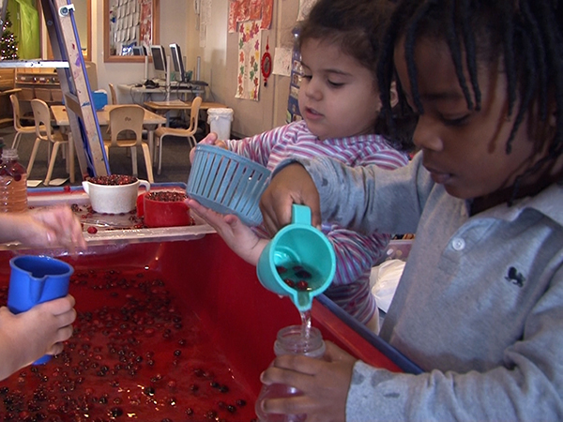
Neurodevelopmental
Ecological
Screening
Tool
An instrument to screen children’s development that can be administered by nonclinical staff in low-resourced settings
Notes:
REFORMAT

Slide 3
Main Features
Screening Tool
Theory behind NEST
Logic model
Psychometrics
Notes:
REFORMAT

Slide 4
Screening
  “ [Developmental] screening provides a quick snapshot of a child’s health and developmental status and indicates whether further evaluation is needed.”
  Source:https://www.researchgate.net/publication/292605313_Early_Childhood_Developmental_Screening_A_Compendium_of_Measures_for_Children_Ages_Birth_to_Five , pp.6
Notes:
REFORMAT

Slide 5

Neurodevelopmental Ecological Screening Tool
  NEST was developed in line with best practice for screening tools used for child development.
  Typical Administration Time:20 minutes.
  Focused on selected areas of interest for a population: Predictors of risk or resilience in early childhood
  Ideal for use for children without serious impairment. Only
  indicates possible presence of developmental delay.
  Most appropriate for use with children ages 3-5 from diverse backgrounds
  living in poverty or homelessness.
  Not a comprehensive assessment of all areas of development. Does NOT definitively identify, diagnose, or describe whether a child has a disability. For those identified as moderate or high risk, a more comprehensive and formal evaluation process is recommended.
Source:https://www.researchgate.net/publication/292605313_Early_Childhood_Developmental_Screening_A_Compendium_of_Measures_for_Children_Ages_Birth_to_Five
Notes:
Put map for where sites were.

Slide 6
Theory behind
NEST
  NEST combines decades of research in child development with the latest advances in computerized clinical decision support systems,
  providing an avenue to universal screening.
Notes:
REFORMAT

Slide 7

Literature Review
Child development
  Multiple Constructs: Motor, Language, Executive Function & Self- regulation, Social-Emotional, Play
Caregiver Funcitoing
  Mental Health: Depression and Trauma
  Parenting
Environmental Influences
  Homelessness, Housing Stability, Food Security, Lead, Health Care Access, Quality of Play Spaces
Notes:
NEST – should be brief
QUESTIONS – multiple choice (online format)

Slide 8
Expert Consensus
Advisory Panel of Experts
  Homelessness, Poverty, Child Development, Risk & Resilience, Mental Health, Trauma, Assessment, Evaluation and Measurement
  Vetted item pool through structured review process
Cogntive testing
Notes:
NEST – should be brief
QUESTIONS – multiple choice (online format)

Slide 9
Empirical Analyses
Gold Standards
  Vineland, BASC-III, PSI-IV
Existing tools
  PHQ9, PCL-6(C), Parenting Scale (5 item), Lead, Food Insecurity, Health Care Access
Notes:
NEST – should be brief
QUESTIONS – multiple choice (online format)

Slide 10
Logic Model
  Despite their strengths, many tools do not fully assess functioning within a broad ecological context.
Notes:
REFORMAT

Slide 11
Motor
Skills
Gross
Fine
Functional Communi-cation
Receptive
Expressive
NEURODEVELOPMENTAL
Cog Processing
Neuro-
development Composite
EF:
Neuro-cognitive
Problem Solving
Attention
Self-Regulation
EF: Adaptability& Coping
Impulse Control
Everyday Challenges
Emotional Regulation
Social-Emotional
Social Skills (peers)
quality
Play
imaginative
Notes:
SHOULD WE CHANGE SELF-REG TO ND SINCE THIS IS THE LOGIC MODEL/SUMMARY (NOT SCORING)?

Slide 12
Mental Health
Trauma
Caregiver
Composite
Depression
CAREGIVER
Parenting

Slide 13
Environment Composite
Food Security
Lead Exposure
ENVIRONMENT
Health Access
ACE
Housing

Slide 14
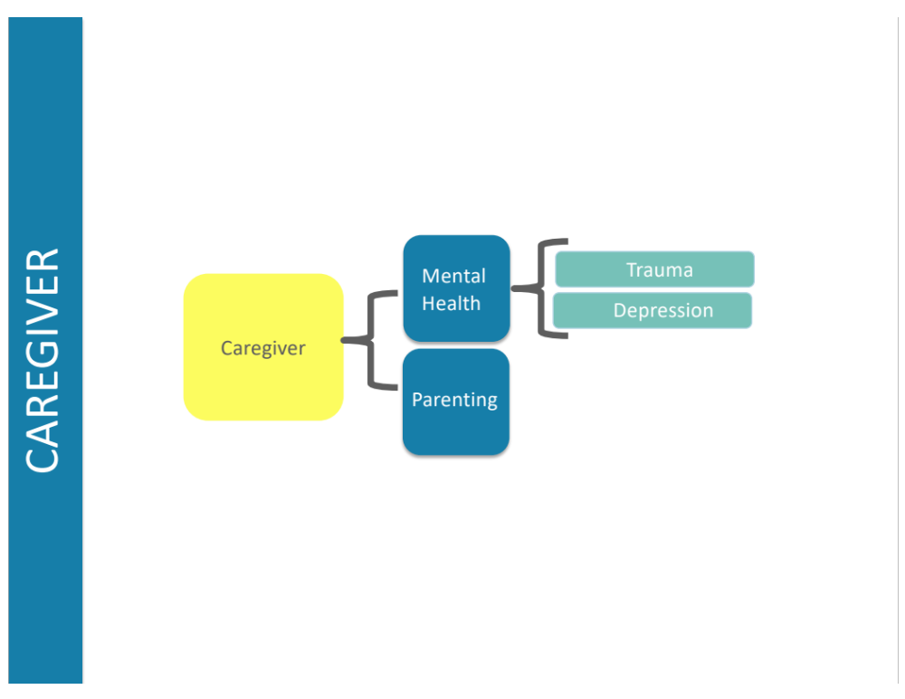
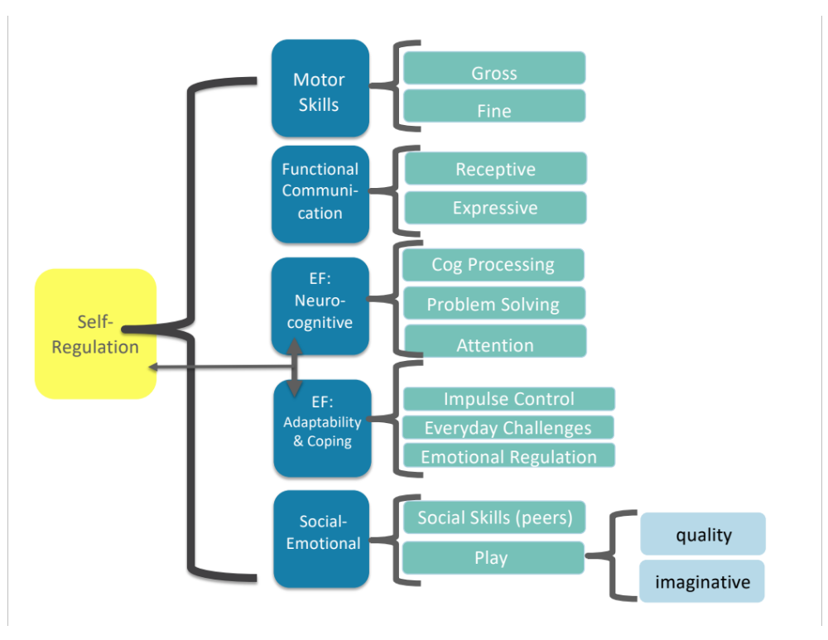
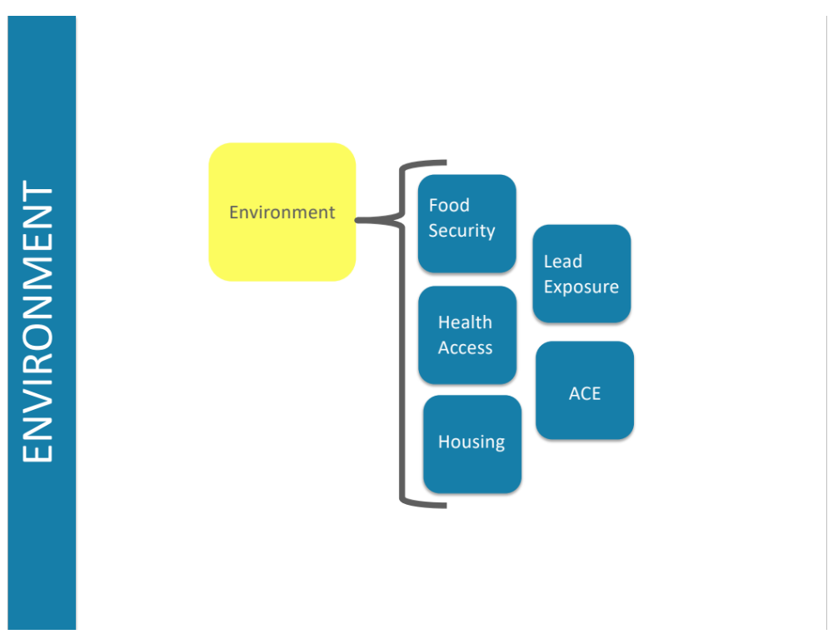
Overall
Child Score

Slide 15
Psychometrics
  NEST combines empirical data with clinical sensitivity to make developmental screening accessible for non-clinically trained frontline workers.
Notes:
REFORMAT

Slide 16
Sample
Child
Caregiver
Average age: 30
Race: 79% nonwhite
SES: Low-Income/Poverty
NEST completed by:
  93% mother, 5% father
Sample n=240 children
Northeast, Southeast, Midwest, West Coast
Gender: 52% male; 48% female
Race: 84% nonwhite
  African American 43%, Hispanic 31%
Notes:
Child Age Freq. Percent Cum.
3 101 40.73 40.73
4 78 31.45 72.18
5 69 27.82 100.00
Total 248 100.00
Child gender Freq. Percent Cum.
M 131 51.78 51.78
F 122 48.22 100.00
Caregiver relation Freq. Percent Cum.
father 12 4.74 4.74
mother 235 92.89 97.63
other 6 2.37 100.00

Slide 17
Data Analyses
Cognitive testing, Item Response Theory (IRT), and Confirmatory Factor Analysis (CFA) methods were used to develop and test the items and constructs for psychometric validity and reliability.
Clinician administered gold standard instruments were used to assess the validity of the NEST measures and to develop scoring for the NEST.
Notes:
Put map for where sites were.

Slide 18
Reliability
Internal Item Fit
  Item properties on the IRT tests and good unidimensionality on the CFAs.
    IRT Fit range .77 to 1.26
Test-Retest n=20
Notes:
Put map for where sites were.

Slide 19
Validity
Gold Standards
  Vineland, BASC-III, PSI-IV
  Alpha range .7-.87
Existing tools
  PHQ9, PCL-6(C), Parenting Scale (5 item), Lead, Food Insecurity, Health Care Access
Notes:
Put map for where sites were.

Slide 20
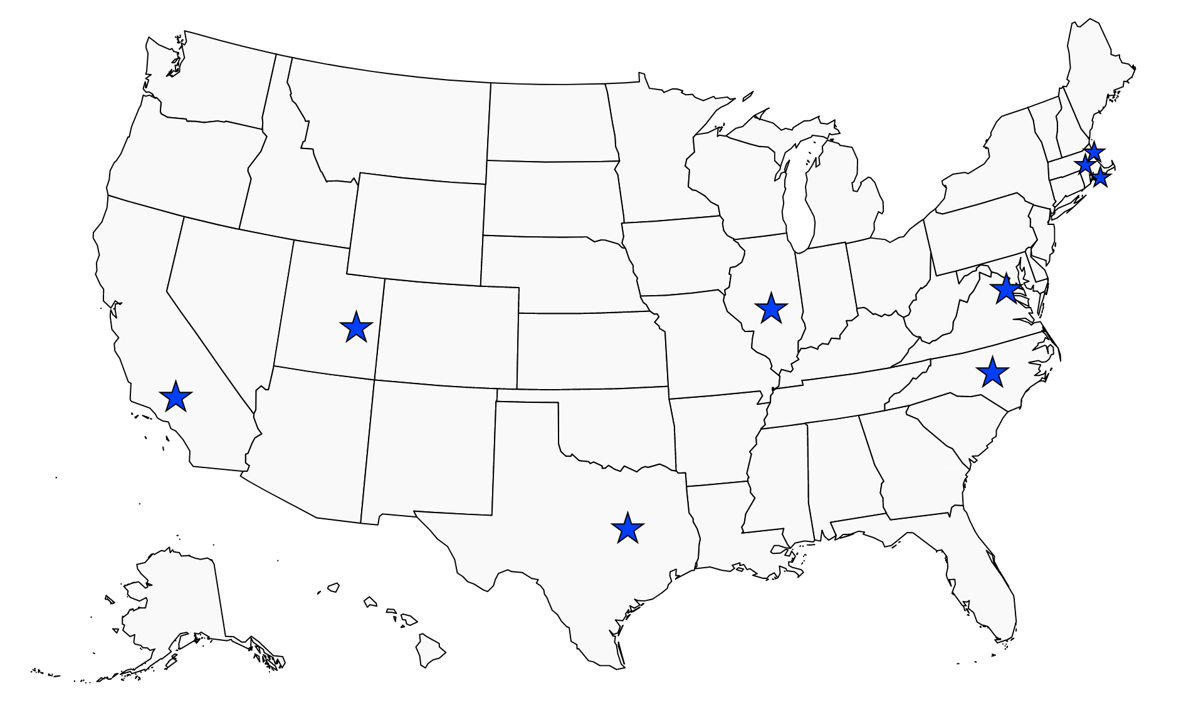
Strengths & Limitations
Strengths
  100% Sensitivity with gold standards for identifying developmental delays.
  Combines Clinical Experience with Empirical Psychometric Data.
  Providers and Families feedback overwhelmingly positive- practical, relevant, ease of use.
Limitations
  Sample of Convenience
  Sample size (n=240) * mitigated through data analysis
  Parent report * mitigated by Gold Standard comparison.
  Moderate Specificity

Slide 21

Final Thoughts
The most potent solutions to pressing social issues often come from a combination of on-the-ground clinical experience and a robust literature base.
NEST was designed to put the right tools in the hands of the people working with low-income children and families.
(DeCandia et al., under review)

