Slide 1
Reporting
Using an Ecological Perspective to Screen Young Children for Developmental Risk and Resilience
Presenter
| Date
Carmela J. DeCandia, Psy.D.∙ Katie Volk, Ph.D.
Notes:
kv
NBCDI – testing across diversity. Why it matters? Look at proposals. CDC – look at class slides.
ACE data
Environmental risks crosswalked to race
Cronholm

Slide 2
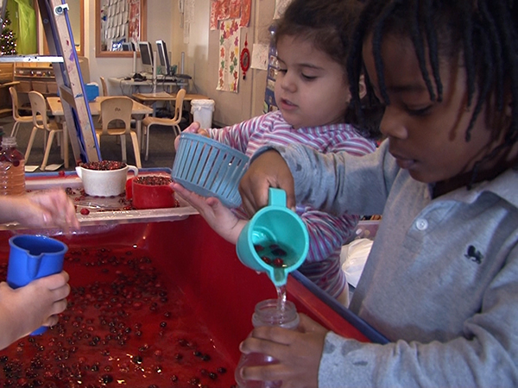
Neurodevelopmental
Ecological
Screening
Tool
An instrument to screen children’s development that can be administered by nonclinical staff in low-resourced settings
Notes:
REFORMAT

Slide 3
Reporting
Understanding NEST Scores
Interpreting results
Making Recommendations
Sharing Results with Families
Monitoring and Re-screening
Types of Reports Available
Notes:
REFORMAT

Slide 4
Understanding NEST Scoring
Notes:
kv

Slide 5
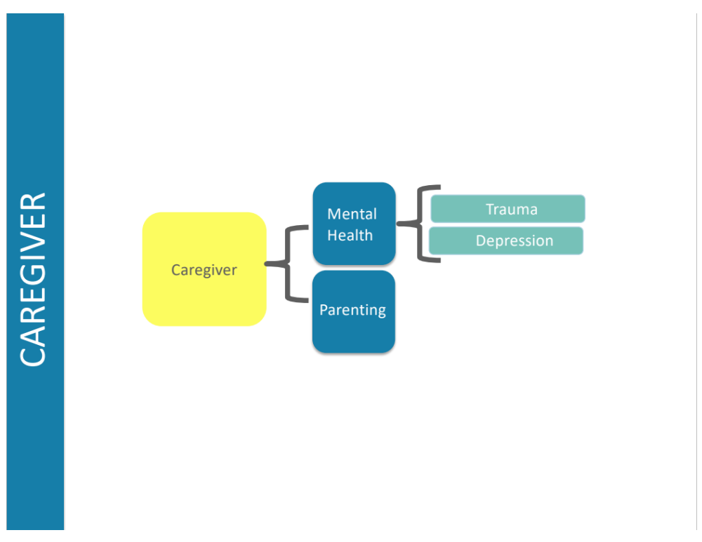
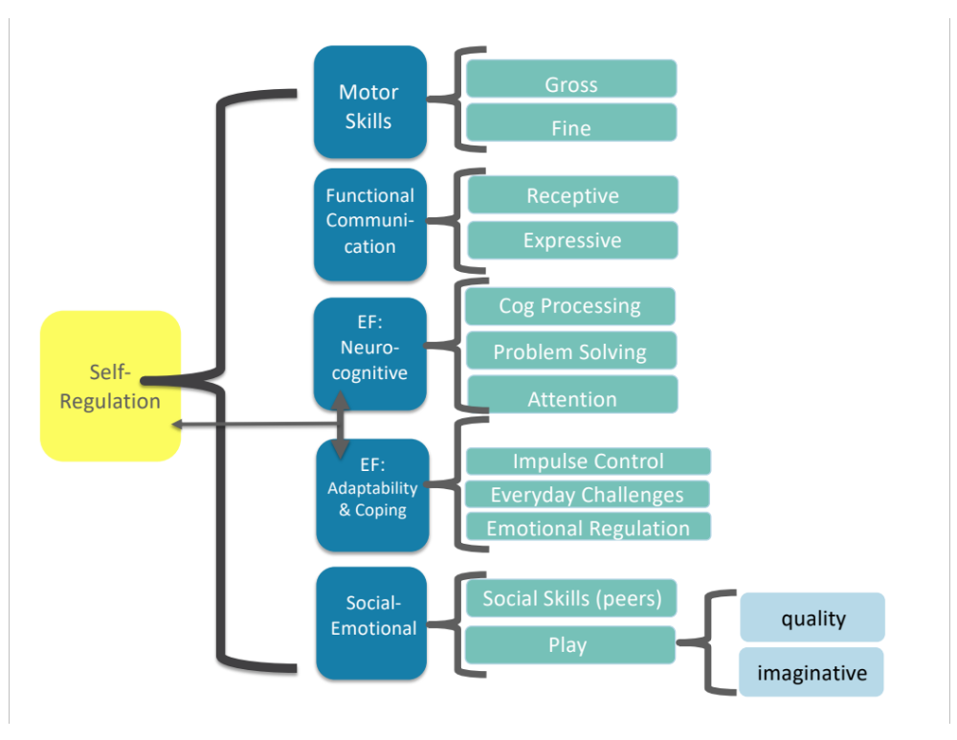
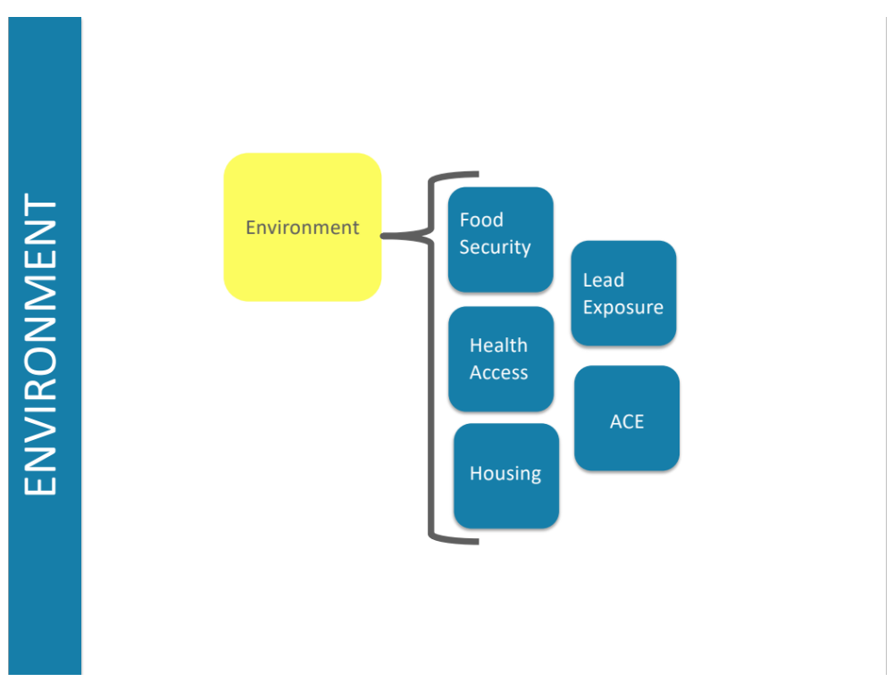
Overall
Child Score

Slide 6
Score Legend
Overall NEST Score
0 = Low risk
1 = Moderate risk
2 = High risk

Slide 7
Interpreting results
Notes:
kv

Slide 8
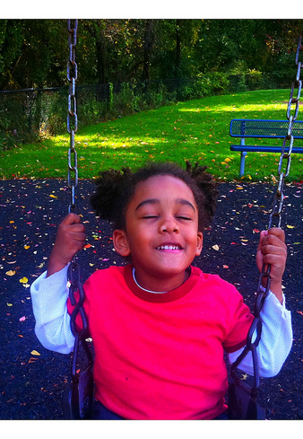
Age-graded Scores
All scores have been adjusted based on what is expected for a child’s age.
Scores are based on 6 month time intervals between ages 3 and 5.
Results provide a snapshot of how a child is developing at a point in time.
Notes:
NEST – should be brief
QUESTIONS – multiple choice (online format)

Slide 9
Overall NEST Score Descriptors
High – Developmental delay is likely.
Moderate-Signs of risk to development are present in some areas, as are signs of resilience.
Low-Child is developing as expected for their age at this point in time and shows signs of resilience.
Notes:
NEST – should be brief
QUESTIONS – multiple choice (online format)

Slide 10
Making Recommendations
Notes:
kv

Slide 11
Match Recommendations to Need
High
Immediate
intervention
Moderate
Targeted support
Low
Support strengths, monitor
Notes:
Support strengths, monitor
Increase support; make referrals
Immediate intervention

Slide 12

NEST Example
Johnny, Age 4

Slide 13
ND: low
Overall Child Score:
moderate
Johnny, age 4
Caregiver: moderate
Environment: high

Slide 14

How do we support Johnny to decrease his risk and support his resilience?

Slide 15
Case Example:
Johnny’s Results at age 4.0
Neurodevelopment: Low
Motor | low
EF/Self-Reg | low
Functional Communication | moderate
Social Emotional | low
Caregiver: Moderate
Depression | moderate
Trauma | high
Parenting | effective
Environment: High
Food security | moderate
Housing | high
Lead exposure | unknown
Health | low
ACE | high

Slide 16
Case Example:
Johnny’s Results at age 4.0
Neurodevelopment: low
Motor | low
EF/Self-Reg | low
Functional Communication | moderate
Social Emotional | low
Environment: high
Food security | moderate
Housing | high
Lead exposure | unknown
Health | low
ACE | high
Caregiver: Moderate
Depression | moderate
Trauma | high
Parenting | effective
Three levels of Recommendations

Slide 17
Sharing Results with Families
Notes:
kv

Slide 18

Individual Reports
    Age adjusted; administer every 6 months for developmental surveillance
    Full printable report immediately upon completion with in depth recommendations based on risk level.
    Graphically Reported.
    Tracks time for next testing.
Source:https://www.researchgate.net/publication/292605313_Early_Childhood_Developmental_Screening_A_Compendium_of_Measures_for_Children_Ages_Birth_to_Five
Notes:
Put map for where sites were.

Slide 19

Partnering with Families
NEST is designed to serve as a communication tool, enabling staff and parents to engage in a structured dialogue about a child and family’s needs,
while screening for potential developmental risk.

Slide 20
Monitoring and Re-screening
Notes:
kv

Slide 21
“With as many as 1 in 4 children at risk for developmental delay, universal early childhood screening provides an opportunity to identify delays early and intervene during the most critical period of development.”
American Academy of Pediatrics

Slide 22
Rescreening with NEST
    Six month intervals from
    ages 3 to 5.
    Scores captured for each domain
    and the overall score on a graph
    for ease of monitoring.
    NEST indicates when the next
    screen is due.
Notes:
Put map for where sites were.

Slide 23

Final Thoughts
For young children, the cascade of consequences associated with growing up in under-resourced settings can be mitigated by early identification, intervention, and support.
NEST’s purpose is to give providers and families the power to implement routine developmental screening of young children –
no matter what their life circumstance.
(DeCandia et al., under review)

